Slide 1
Global, Regional, and Interprocedural Optimization
CSIE 5054: Advanced Compiler Design
Instructor: Shih-wei Liao

Slide 2
Table of Contents
Global Optimization
Global Code Placement with Runtime Profiling: Kevin
Regional Optimization
Loop Unrolling: Lien
Code Motion: Wendell
Interprocedural Optimization: Wendell
Inline Substitution
Procedure Placement
Notes:
在上週時，我們有介紹了透過靜態的分析方法，來得到程式上的某些性質，進而幫助我們進行優化，
我們舉了一個例子是想要找出說未初始化的變數，我們的方法是判斷在 entry block 中離開時要是 live 的變數，他就是 possible 的 candidates，我們利用 data-flow analysis 的框架，將 liveness 的性質 formulate 成一個可解的定義方法，並利用 iterative fixed-point algorithm，來得到 liveness。
但同時，我們也有介紹到 data-flow analysis 的方法有他的限制，他會考慮在 Control flow graph 中所有的 paths 發生的可能性，導致就算因為一些 runtime behavior ，某些 path 不會發生，我們仍會假設他發生，而後續的優化就會相對保守。
所以我們今天會介紹另一套分析方法，我們透過分析程式在某些具有代表性的資料上的行為，透過這些行為回過頭來幫助我們的優化，這種分析執行期間的行為會為 runtime profiling，我們會介紹到另一個 global optimization 為 global code placement，會基於這些執行期間得到的資訊，來幫助他的優化。
再來，我們上週也有提到我們的優化方法，不僅僅是只能考慮一整個 program，我們也可以考慮到不同大小的範圍來做不同的優化，下面會分別帶到另外兩種不同 granularity 的優化方法，還有個別的例子。

Slide 3
Optimization: Finding the Opputurnities
Compiler optimizations leverage opportunities from:
Programmer behavior
Advances in computer architecture
For example:
Finding the uninitialized variables: Addressing potential bugs from programming oversights
Instruction selection: Choosing the most efficient machine instructions for specific hardware to improve performance.
Notes:
那我們在設計 optimization 的各種 pass 時，其實就是不斷的在往上或往下找哪裡還有可以優化的空間，
往上，我們需要熟悉 programmer 撰寫程式時的行為，舉例來說，我們上週介紹的優化是找出程式中沒被初始化的變數，那大家可以想一件事是，如果全世界的所有 programmer 都有好好的初始化變數的話，那我們這邊的優化就是無效的嘛，所以我們要好好感謝那些粗心的 programmers，給了我們可以設計優化的空間。
那往下呢？我們就必須要去看說底層的硬體架構的演進，給了我們哪些機會可以設計我們的優化，一個直觀的例子是：當底層的 cpu 提供更強的 instructions 我們可以使用時，compiler 設計人員必須要熟悉這件事，才能夠使用到這些好處，來提昇效能。

Slide 4
Another Global Optimization: Global Code Placement
Oppurturnities: Many processors have asymmetric branch costs.
The cost of a fall-through branch is less than the cost of a taken branch.
Fall-through branch: A one-address branch is either taken or execution falls through to the next operation in sequence.
Notes:
所以我們就來看說我們今天會講到的另一個 global optimization 是 global code placement 這個優化他是源於什麼機會，
導致我們有優化的空間，這個優化主要是基於一個處理器上的特性是，假設我們考慮一個 branch 指令是假設 condition 成立，就跳到對應的 label 執行，否則就執行下一個指令。
我們下面會稱 condition 成立時，跳到遠方的位址執行叫做 taken branch，反之，執行下一個指令的就叫 fall-through branch。
那現今的處理器上有一個特性是：taken branch 的 cost 會大於 fall-through branch 的 cost，那我們下面會介紹說我們如何利用這個特性來設計我們的優化。

Slide 5
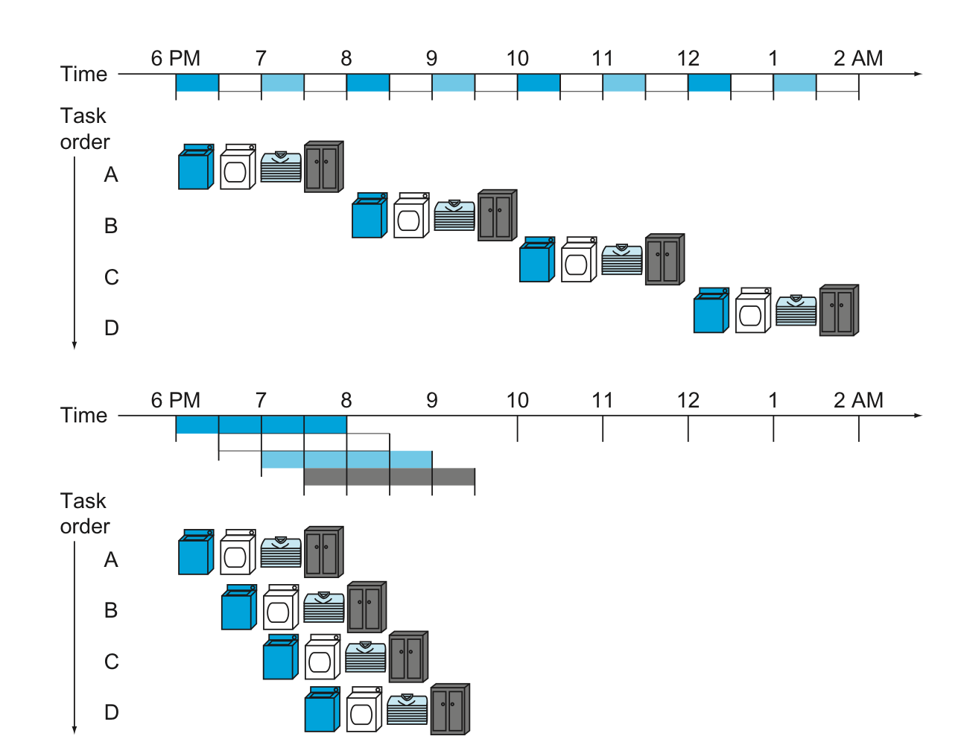
Pipelining in Computer Architecture
Notes:
但實際介紹優化之前，我們先來看一下為什麼處理器上會這樣的特性。

Slide 6
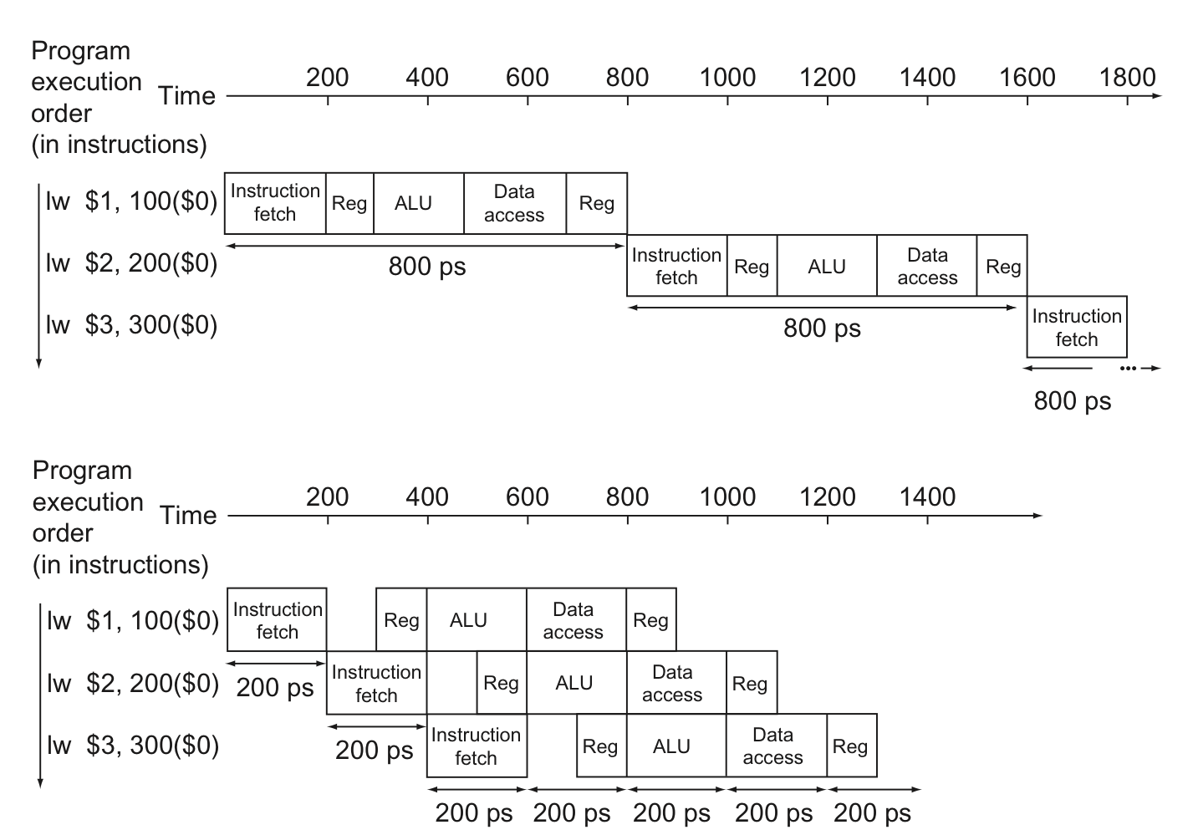
Pipelining in Computer Architecture
Notes:
P406

Slide 7
Control Hazard & Pipeline Stall (Bubble)
Control Hazard: The instruction that was fetched is not the one that is needed.
Pipeline Stall (Bubble): A stall initiated in order to resolve a hazard.
Suppose the computer always predict the branches will be untaken.
Notes:
P406

Slide 8
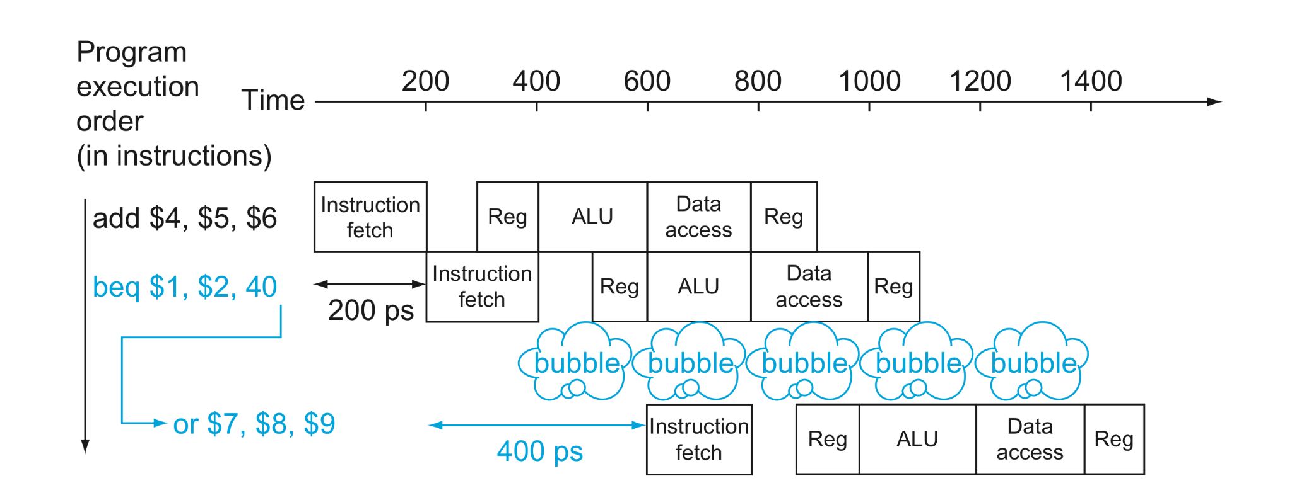
Control Hazard & Pipeline Stall (Bubble)
Notes:
P406

Slide 9
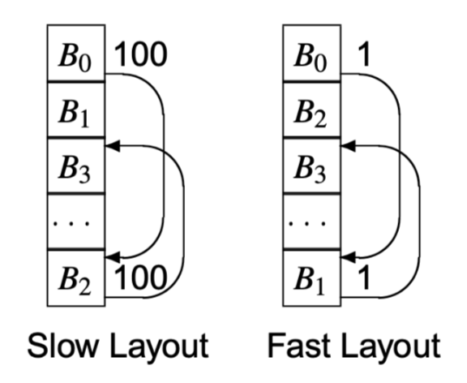
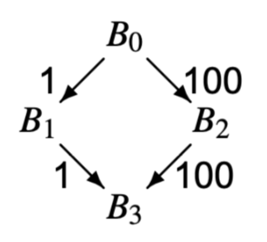
Intuition in Global Code Placement
Notes:
那回過頭來，我們既然知道 taken branch 的 cost 會比 fall-through branch 來的高，我們設計 compiler 時，就能善用這點，假設我們知道每個 block 往下走到另外兩個 block 的執行頻率，我們是不是就可以把執行頻率較高的 block，放在 fall-through branch，以降低整個 branch out 的 cost。

Slide 10
Three Steps in Global Code Placement
Analysis: Estimate the relative execution frequency of each edge on CFG.
Pre-computing: Construct the set of CFG paths that include the most frequently executed edges and the partial order on the set of basic blocks.
Transformation: Place all of the basic blocks into a fixed linear order.
Notes:
實際上在做 global code placement 時，我們可以拆解成三個步驟，
第一個步驟就是我們需要知道在 control-flow graph 上各個不同的邊他的執行的相對頻率。
第二個步驟則是

Slide 11
Obtaining Profile Data
Instrumented executables: Compiler generates code to count specific events, such as procedure entries and exits or taken branches.
Timer interrupts: Interrupt program execution at frequent, regular intervals. The tool constructs a histogram of program counter locations where the interrupts occurred.
Performance counters: Many processors offer some form of hardware counters to record hardware events, such as total cycles, cache misses, or taken branches.
Notes:
mcycle in RISC-V，透過讀取 machine-level register 可以得到 total number of cycles。

Slide 12
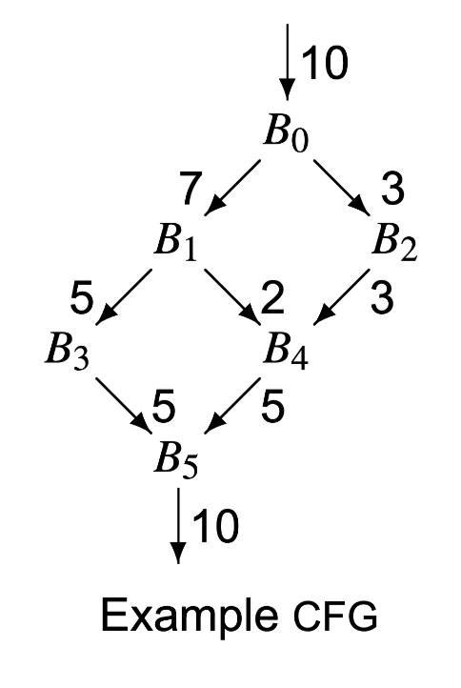
The Accuracy of Profiling Matters
The code-placement algorithm uses profile data to rank the CFG edges by frequency of execution.
Thus, accurate edge data has a direct effect on the quality of the results.

Slide 13
Greedy Algorithm to Find Hot Paths
Hot Path: A CFG path that include the most frequently executed edges.
Each path is a chain of one or more blocks.
Each path has a priority that will be used to construct the final code layout.
Notes:
有了 CFG 上各個邊的執行頻率後，再來，我們想要找出怎樣利用這些邊的執行頻率的資料，來得到可以使得最後 branching cost 最小的一個 layout，那一個 greedy 的方法就是我們去蒐集那些 frequency 高的邊，如果這些邊可以構成一條 path 的話，那我們就將這條 path 上的 blocks 最後排列時擺放在一起，那在走訪這條 path 時，就都會是 fall through branch 了。
那我們想找的就是這些我們稱作為 hot path 的 basic block 構成的 chain，那我們會對每條 hot path 賦予一個 priority 的值，這是為了在後續實際做 transformation 時會用到的。

Slide 14
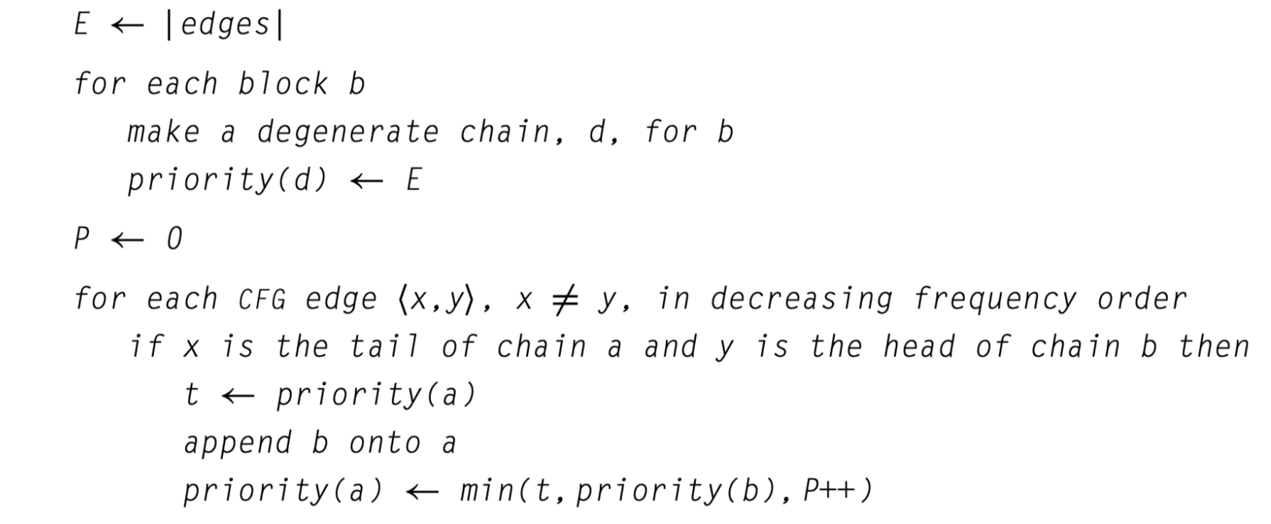
Greedy Algorithm to Find Hot Paths: Algorithm
Degenerate Chain: A chain that consists only of a basic block itself, without having merged into any other blocks yet.
Notes:
下面就是我們找出 hot paths 的實際的演算法，那在這個演算法中，假設一共有 n 個 basic blocks 時，那他會初始化產生 n 個 denerate chain，並且每個 chain 給予一個足夠高的 priority。
再來，我們假設前面分析時，我們有先依照頻率高低對所有邊進行排序，那這裡就由頻率高至低對每條邊操作，假設考慮一 <x, y> 為 x 走向 y 的邊，且 x 會為他所在的 chain 的 tail 且 y 會為他所在的 chain 的 head。

Slide 15
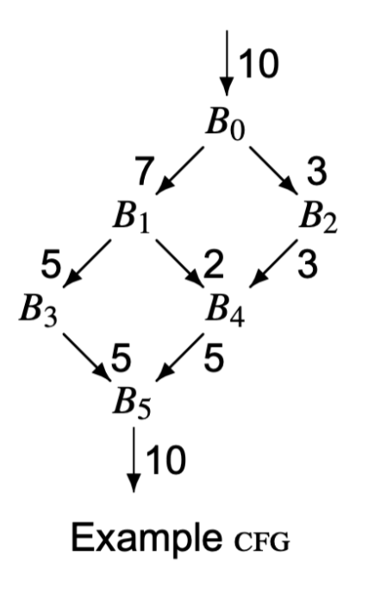
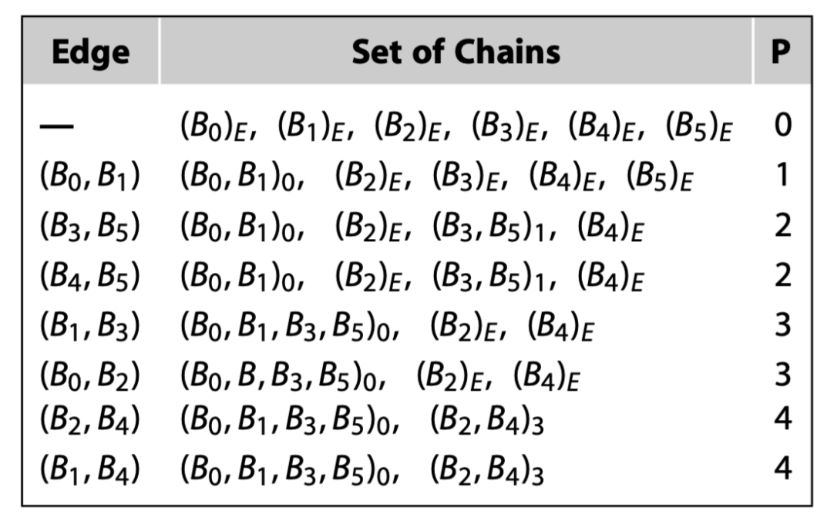
Greedy Algorithm to Find Hot Paths: Illustration
Notes:
Each node belongs to exactly one chain.
The priority values of each chain encode an order for relative layout of the chains that approximates the maximal number of executed forward branches.
Breaking ties among equal-priority edges in a different way can produce a different set of chains.
Different chains may produce different code layouts. The layout algorithm still produces good results, even with a nonoptimal ordering for the equalweight edges.

Slide 16
Performing Code Layout: Two Heuristics
Place the blocks of a chain in order, so that fall-through branches implement the chain’s edges.
Choose among alternatives using the priority number recorded for the chains.

Slide 17
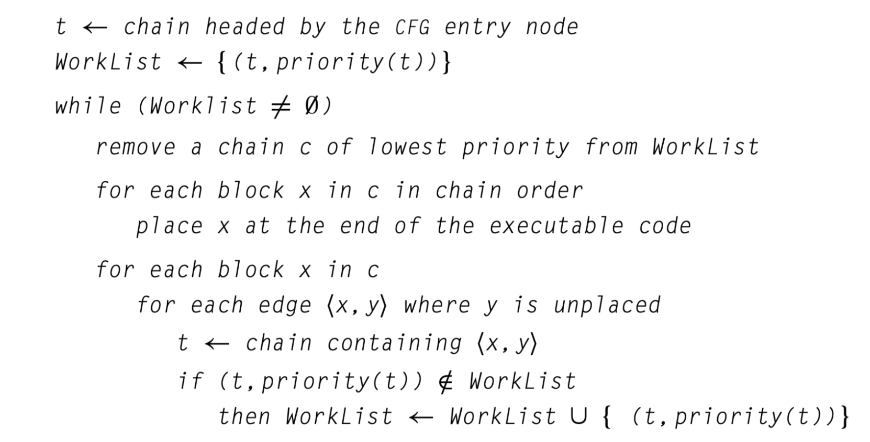
Performing Code Layout: Algorithm

Slide 18
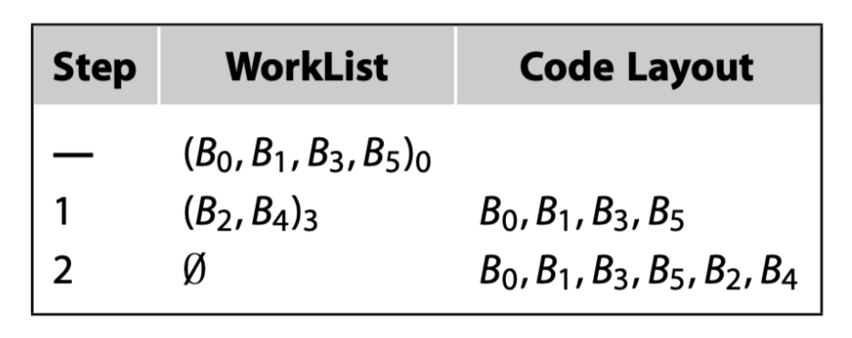
Performing Code Layout: Illustration

Slide 19
Breaking ties among equal-priority edges matters
Breaking ties among equal-priority edges in a different way can produce a different set of chains.
Different chains may produce different code layouts.

Slide 20
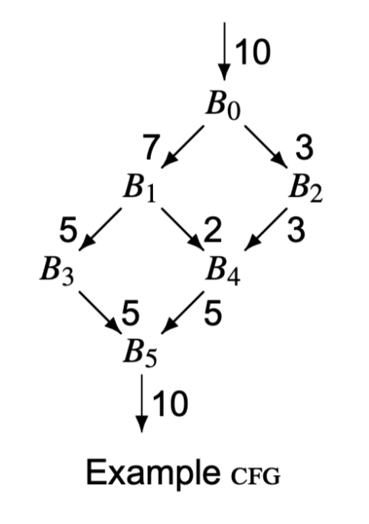
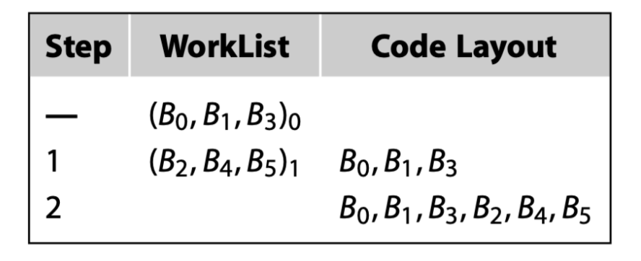
Breaking ties among equal-priority edges matters

Slide 21
Data-flow analysis v.s. Runtime profiling
Data-flow analysis is conservative, in that it accounts for all possibilities.
Runtime profiling is aggressive, in that it assumes that future runs will share runtime characteristics with the profiling run.

Slide 22
Regional optimizations
Optimizations that focus on regions larger than a basic block and smaller than a whole procedure.
In some cases, considering a subset of the code for the full procedure produces sharper analysis and better transformation results than would occur with information from the full procedure.
Notes:
For example, inside a loop nest, the compiler may be able to prove that a heavily used pointer is invariant (single-valued), even though it is modified elsewhere in the procedure. Such knowledge can enable optimizations such as keeping in a register the value referenced through that pointer.
再來我要講Regional Optimization, 局部優化，意思就是優化多個basic block,而不直接優化整個function或整個program
有時候用局部優化，會比global Optimization還好
舉個例子，如果在loop裡面有變數，它不會被修改，就可以把變數移出loop body再進行優化

Slide 23
Regional optimizations
Limiting the scope of a transformation to a region smaller than the entire procedure allows the compiler to focus its efforts on heavily executed regions.
For example, the body of a loop typically executes much more frequently than the surrounding code.
Notes:
For example, inside a loop nest, the compiler may be able to prove that a heavily used pointer is invariant (single-valued), even though it is modified elsewhere in the procedure. Such knowledge can enable optimizations such as keeping in a register the value referenced through that pointer.
再來，將範圍限制在比整個function或program更小的區域內，可以讓編譯器對執行頻繁的區域優化，像是loop body。

Slide 24
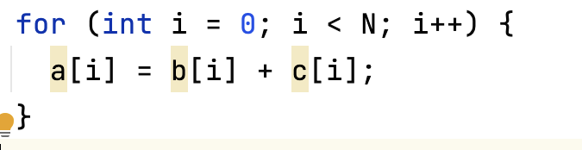
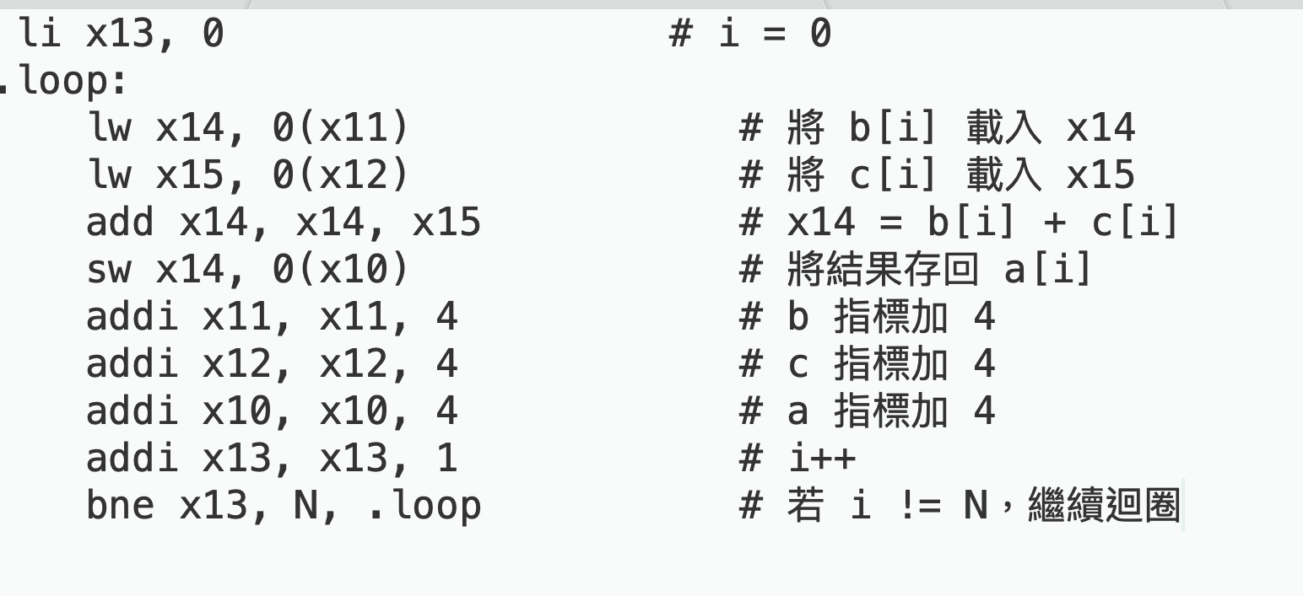
Loop unrolling: An example
Notes:
再來我要講loop unrolling
首先來看這個for loop, 它每回合都只執行一個加法運算，而且每回合都data independency
下面是編譯後的risc-v的組合語言 先load兩個memory的值到register
然後立即做運算

Slide 25
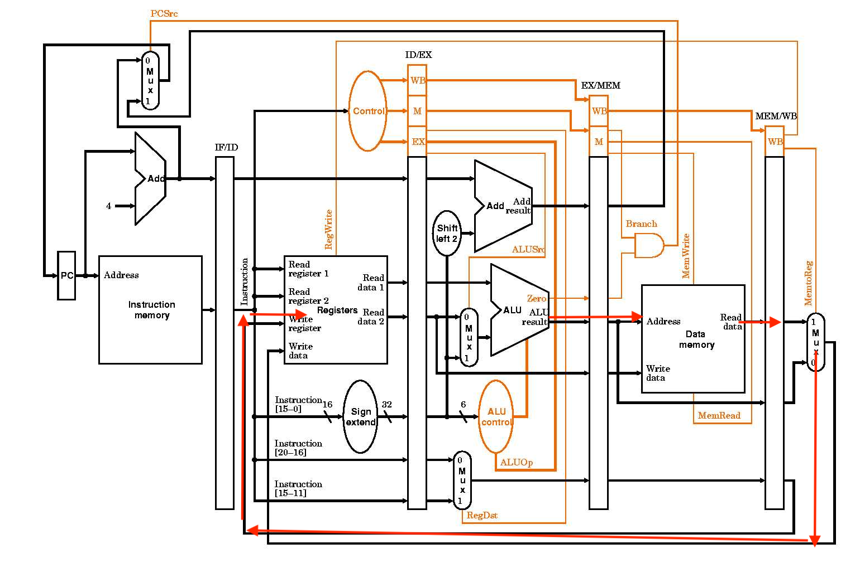
Loop Unrolling: An Example
If immediately use data after load instruction, the cpu pipeline will stall
Notes:
大家應該都修過計算機結構吧?
ALU會先產生memory address, 然後經過一個pipe到memory cache,再經過一個pipe,才把值傳給register file, 又要再等一個pipe, 才存進register裡
如果立即對load的資料做計算，會讓pipeline stall

Slide 26
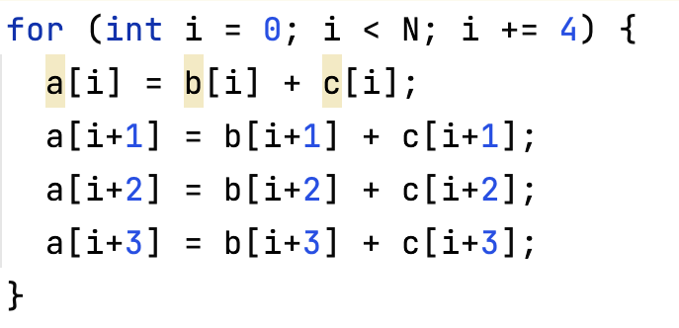
Loop unrolling: An example
Notes:
再來看到unrollling的樣子，這段code只是示意圖，不需要programmer這樣寫，只是翻出來的組合語言再反編譯的話，大概會長這樣子
for loop一回合做四次運算，下面show出組合語言

Slide 27
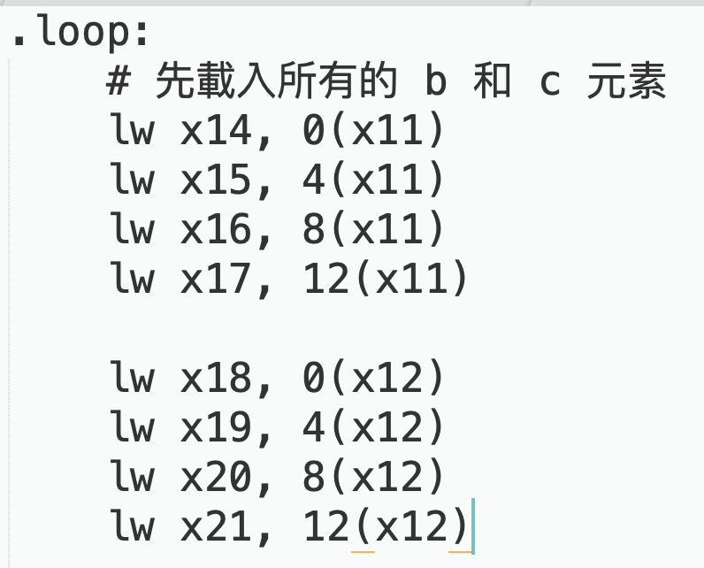
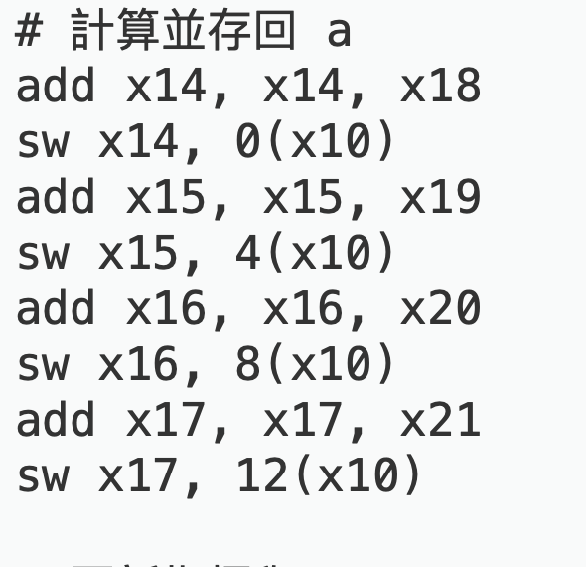
Loop unrolling: An example
Notes:
這個組合語言分成三段，第一段是load所有要在這一回合使用的資料，之後做ALU運算和儲存 (下一頁)
從第一個指令load資料到x14這個register，到他被使用前，經7個instruction，這個緩衝期間足以讓運算開始時，register的資料已經準備好了
而且拆成連續data independent的指令，在有superscalar架構的CPU，可以增加平行化程度

Slide 28
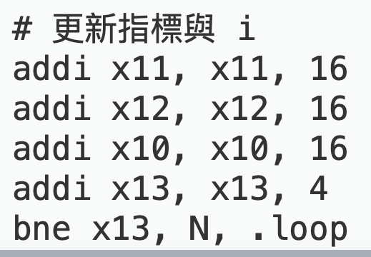
Loop unrolling: An example
Notes:
然後再判斷for loop的返回條件(回上頁)

Slide 29
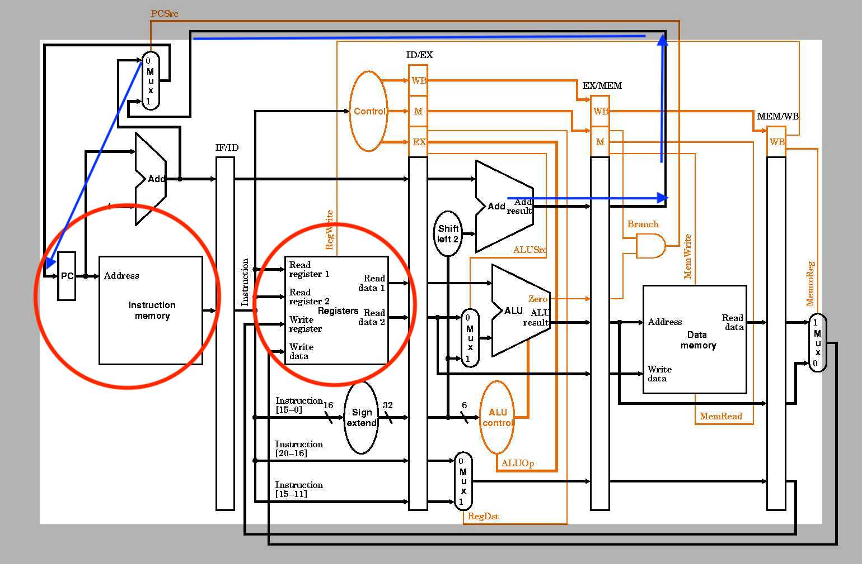
Loop unrolling: Branch prediction miss
Less Branch instruction executes
That means less branch prediction
Notes:
除了上面的好處，還有另一個比較小的好處，就是對減少branch prediction miss有用
藍色的線是branch的data path，他在跟ALU同個pipe裡面做add運算，再經過一個pipe，才會存回program counter
如果branch prediction錯誤的話，在圖中圈起來的兩個pipe就要clean掉，浪費兩個clock cycle
loop unrolling後會減少branch的次數，原本的code每8個指令就會執行一次branch, unrolling後每20個指令才執行一次branch
另外有些嵌入式的微處理器可能根本沒有branch prediction，所以它的prediction就是下一個指令，但是在for loop的例子，大部分的branch都會往前面jump過去，只有在最後一次loop回合，才會執行branch的下一條指令

Slide 30
Loop unrolling: The Goods
Increasing the number of independent operations in the loop body improves instruction scheduling opportunities.
Amortizing loop control overhead across multiple iterations with each unroll reduces the impact of loop management.
Notes:
再來看看loop unrolling有什麼好處，第一個是它可以產生多個data independent的指令
另外還有可以減少loop每次判斷返回條件的overhead

Slide 31
Loop unrolling: The Bads
Increasing program size, both in its IR form and its final form as executable code. This maybe causes Instruction cache miss.
The unrolled loop body may place a higher demand on registers compared to the original loop, potentially requiring additional register management.
Notes:
但是loop unrolling可能也會有另外的overhead
unrolling後，編譯出的binary的size會增加，增加太多可能一個cache block裝不下，要多一個cahce block去裝，這可能產生額外的cache miss
另外unrolling後會需要在loop的每一回合，allocate更多的register
當register用完後，就要把資料存到memory，下次要用到時，又要再做load，增加cache miss的機率

Slide 32
Code motion
Moving a sequence of code to a point where it runs less frequently should reduce the total operation count of the running program.
Lazy Code Motion (LCM) is a such transformation that moves loop-invariant code. LCM may move the code out of loops, which may speed up the execution.
LCM finds operations that are partially redundant, inserts code to make them redundant, and deletes the newly redundant expression.
Notes:
Code motion是一種 regional opt 記得優化的兩個考量, safety and profitability. Code motion前提是不影響整個程式代表的運算, 這就是為什麼可以做 Code Motion. 這裡的profit就講的比較general，因為target program code size或許不變, 或不會比較快, 所以只講比較確定的 total .. program. LCM 找出

Slide 33
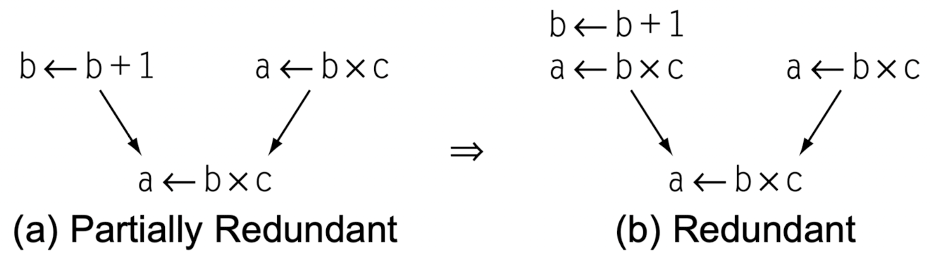
Redundancy
Partially Redundant: An expression e is partially redundant at p if it occurs on some, but not all, paths that reach p.
Redundant: An expression e is redundant at p if it has already been evaluated on every path that leads to p.

Slide 34
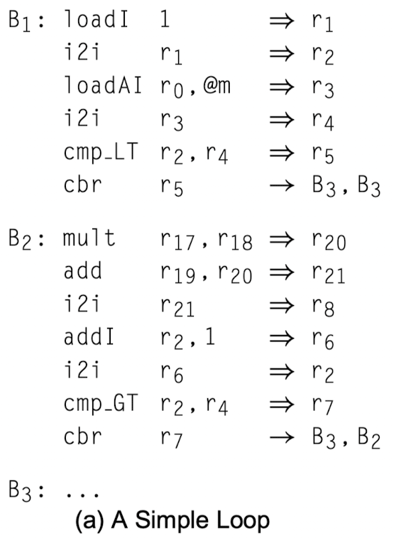
Lazy Code Motion (LCM): Assumptions
Texturally Identical expressions use the same name. So a name can represent its specific expression.
E.g., we can use r₂₁ to represent r₁₉ + r₂₀.
Program variables are set by copy operations.
E.g., i2i r₁ ⇒ r₂ set program variable stored in r₂.
In Figure (a), the variables are r₂, r₄, and r₈.
r₁, r₃, r₅, r₆, r₇, r₂₀, and r₂₁ are expressions.
For a non-copy operation represented as “op r_{i} r_{j} ⇒ r_{k}”, i < k and j < k.
2
Notes:
A name represents an expression would not be redefined.

Slide 35
Lazy Code Motion: Steps
Solve the two data-flow problems:
Available Expressions
Anticipable Expressions
For each CFG edge, compute the set of expressions that the edge is earliest placement for the expressions.
Solve the third data-flow problem later placement.
Computes the two sets INSERT and DELETE.
Rewrite the code.

Slide 36
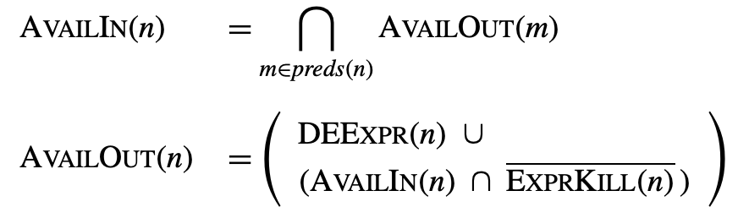
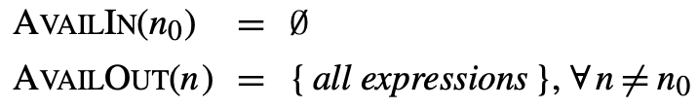
Available Expressions
An expression e is available on exit from block b if
along every path from n₀ to b, e is evaluated and none of its operands are redefined.
DEEXPR(n): The expressions whose operands are not redefined afterwards.
EXPRKILL(n): In block n, the expressions whose operands are killed.
The inital values are:
Notes:
lecture04.pdf (cam.ac.uk)

Slide 37
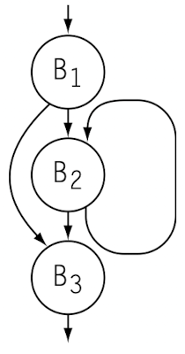
Available Expressions Example
Build CFG
2

Slide 38
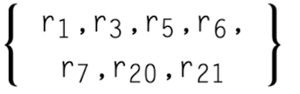
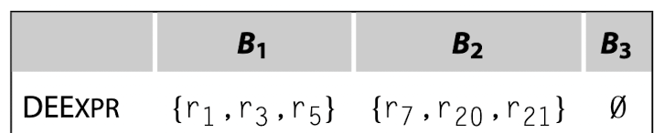

Available Expressions Example (Cont’d)
Gather Initial Information
{all expressions} is
2
Notes:
B3中

Slide 39
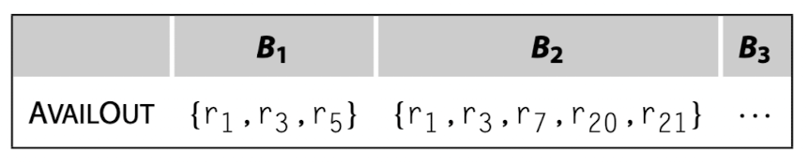
Available Expressions Example (Cont’d)
Solve the equation by CFG and initial information.
AVAILOUT(B₁) = DEEXPR(B₁)
AVAILOUT(B₂) = DEEXPR(B₂) ∪ (AVAILOUT(B₁)∩AVAILOUT(B₂) ∩ (EXPRKILL(B₂) )
CFG
{all expressions} is

Slide 40
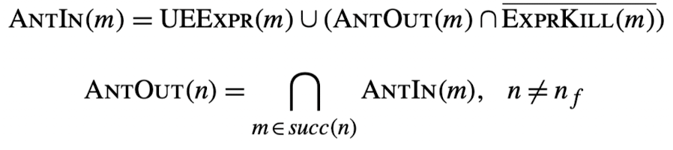

Anticipable Expressions
An expression e is anticipable on exit from block n if every next block m
evaluates e and subsequently uses the e or
has the first evaluation of e the same as evaulating e at the end of block n.
UEEXPR(n): The expressions whose both operands are not redefined before in n.
The inital values are:

Slide 41
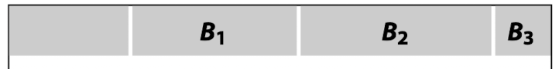
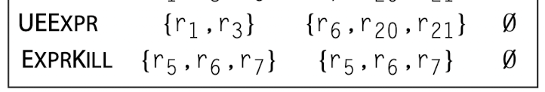
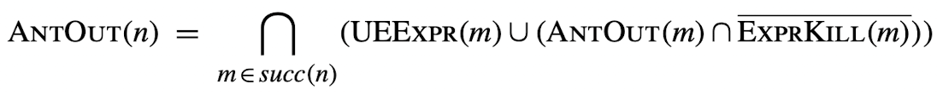
Anticipable Expressions Example
: Example
Build CFG
Gather Initial Information
{all expressions} is
2
Solve the Equations
 | B₁ | B₂ | B₃
ANTIN | {r₁,r₃} | {r₆, r₂₀, r₂₁} | ∅
ANTOUT | ∅ | ∅ | ∅
Notes:
In B1
r5’s operands r2, r4 are redefined before.
In B2
r21’s operands are expression, which are not redefined by assumption.
r7’s operand r2 is redefined before.

Slide 42

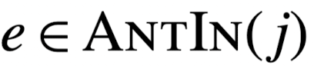
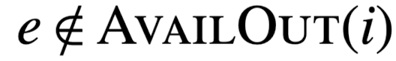
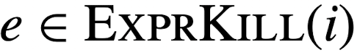
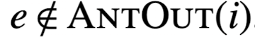
Lazy Code Motion: Earliest Placement
For a CFG edge (i, j), an expression e is in EARLIEST(i, j) if and only if we can move e to (i, j), and cannot move it to any earlier edge in the CFG.
means e can be safely evaluated before the block j.
shows no prior e is available in the earlier block i.
are the two cases of earliest placement:
, so (i, j) is the earliest point to place e right after e is kiiled.
means that e in earlier block i has some next block not anticipable e to go in.

Slide 43
Lazy Code Motion: Earliest Placement Example
In the example, we can compute the EARLIEST(i, j) for each edge i, j by
 | B₁ | B₂ | B₃
ANTIN | {r₁,r₃} | {r₆, r₂₀, r₂₁} | ∅
AVAILOUT | {r₁, r₃, r₅} | {r₁, r₃, r₇, r₂₀, r₂₁} | …
EXPRKILL | {r₅, r₆, r₇} | {r₅, r₆, r₇} | ∅
ANTOUT | ∅ | ∅ | ∅
 | (B₁, B₂) | (B₁, B₃) | (B₂, B₂) | (B₂, B₃)
EARLIEST | {r₆, r₂₀, r₂₁} | ∅ | {r₆} | ∅

Slide 44
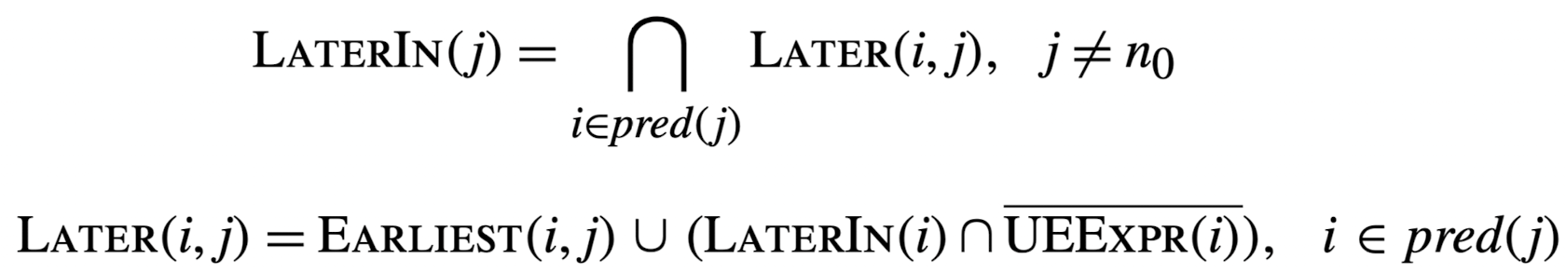
Later Placement
Later Placement determines how late a earliest placement can be deferred to while achieving the same effect. The equations are as follows:
The initial LATERIN(n₀) = ∅, and LATERIN(n) = { all expressions }, ∀ n ̸= n₀.

Slide 45
Later Placement Example
In the example, we have
 | (B₁, B₂) | (B₁, B₃) | (B₂, B₂) | (B₂, B₃)
EARLIEST | {r₆, r₂₀, r₂₁} | ∅ | {r₆} | ∅
We can then compute
 | (B₁, B₂) | (B₁, B₃) | (B₂, B₂) | (B₂, B₃)
LATER | {r₆, r₂₀, r₂₁} | ∅ | {r₆} | ∅
 | B₁ | B₂ | B₃
LATERIN | ∅ | {r₆} | ∅

Slide 46


Lazy Code Motion: INSERT & DELETE
LCM computes the expressions sets INSERT(i, j) for each edge ⟨i, j⟩ to insert and DELETE(i) for each block i to delete.
DELETE(i) = ∅, i = n₀

Slide 47
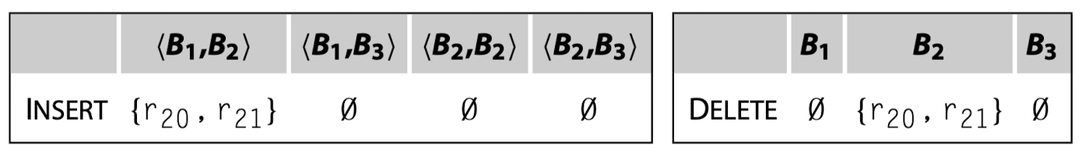
Lazy Code Motion: INSERT & DELETE Example
Continuing the example:
 | B₁ | B₂ | B₃
UEEXPR | {r₁, r₃} | {r₆, r₂₀, r₂₁} | ∅
LATERIN | ∅ | {r₆} | ∅
 | (B₁, B₂) | (B₁, B₃) | (B₂, B₂) | (B₂, B₃)
LATER | {r₆, r₂₀, r₂₁} | ∅ | {r₆} | ∅
We have

Slide 48
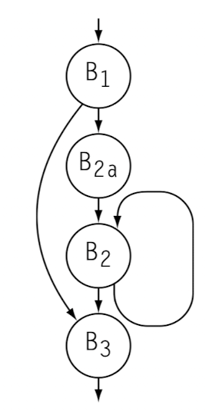
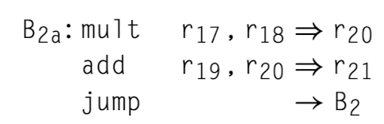
Lazy Code Motion: Rewrite the Code
For each expression e in INSERT(i, j), we insert as follows:
If i has only one successor, we insert the expressions at the end of block i.
else If j has only one predecessor, we insert the expressions at the entry of block j.
else, we split the the edge (i, j) by creating a new block to insert the expressions.

Slide 49
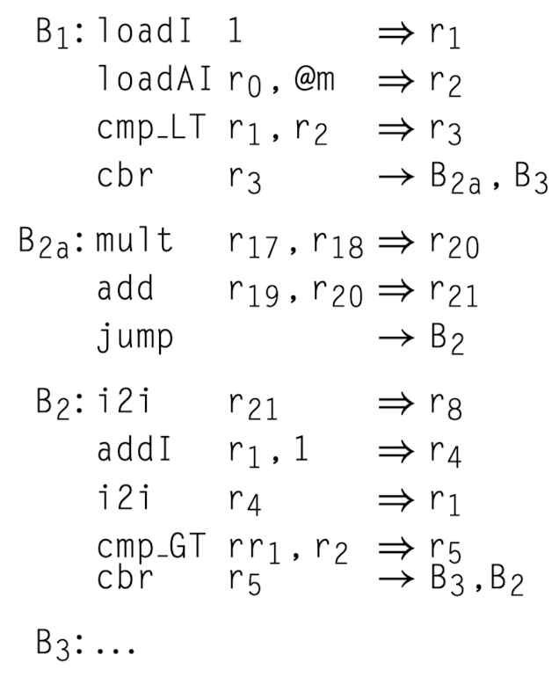
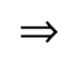
Lazy Code Motion: Rewrite the Code (Cont’d)
Finally, for each block i, we delete the expressions in DELETE(i).
2
LCM

Slide 50
Interprocedural Optimization
Division of a program into multiple procedures has both positive and negative impacts.
On the positive side, it limits the amount of code that the compiler considers at a time. E.g., the scope of global optimization is a procedure.
On the negative side:
The division of the program into procedures limits the compiler’s ability to understand what happens inside a call.
Each procedure call introduces overhead from procedure linkage code (pre-call, post-return, prolog, and epilog).

Slide 51
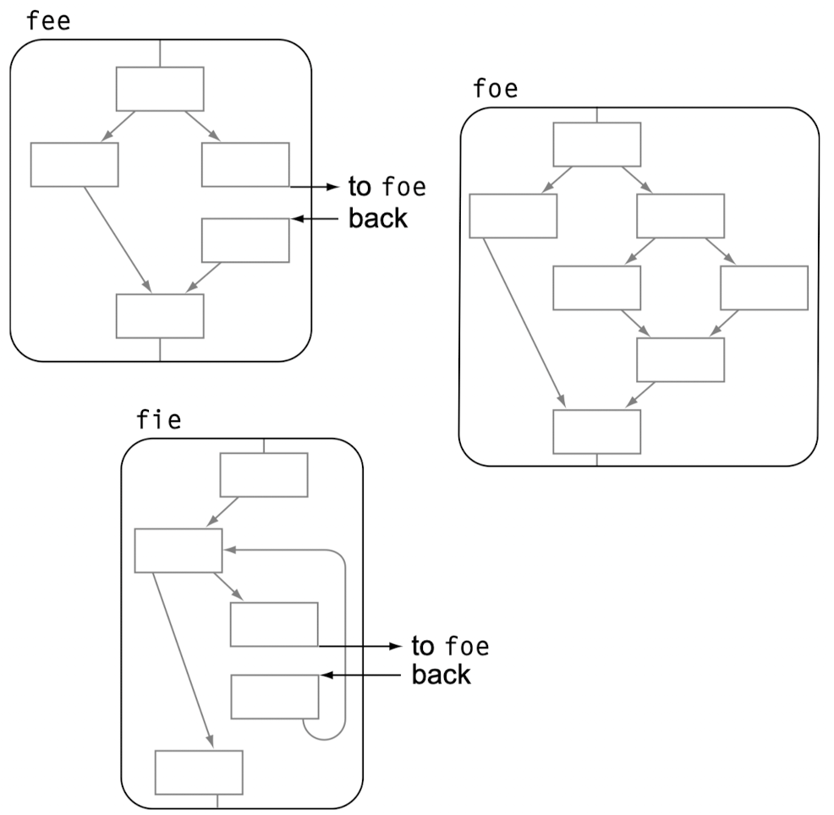
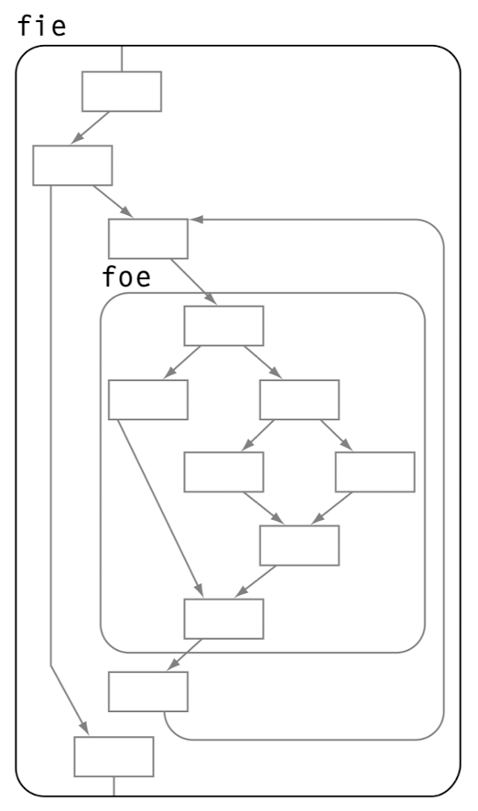
Inline Substitution
Inline substitution can improve the efficiency of the final code by replacing the call site with a copy of the callee’s body, in some cases.

Slide 52
Inline Substitution: Decisions
Decisions for inline substitution examine a variety of criteria at each call site. These cases include:
Callee size: Whether the callee is smaller than the procedure linkage code.
Caller size: The compiler may limit the overall size of any procedure.
Dynamic call count: An improvement at a frequently run call site provides greater benefit than the same improvement at an less run call site.

Slide 53
Inline Substitution: Decisions (Cont’d)
Constant-valued actual parameters: Known-constant values at a call site may be improved as those constants may be folded into the callee.
Static call count: Any procedure called from just one call site can be inlined without any code space growth.
Parameter count: The number of actural parameters is proportional to the cost of the procedure linkage code.

Slide 54
Inline Substitution: Decisions (Cont’d)
Calls in the procedure: Procedures that contain no calls are often good candidates for inlining.
Loop nesting depth: Call sites in loops execute more frequently than call sites outside loops.
Fraction of execution time of the whole program.
In practice, compilers precompute some or all of these metrics and then apply one or more heuristics to determine which call sites to inline.

Slide 55
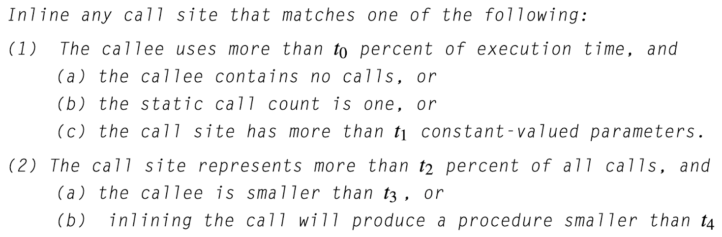
Inline Substitution: Heuristic
Below is a typical decision heuristic, where t0, t1, …, t4 are program specific.

Slide 56
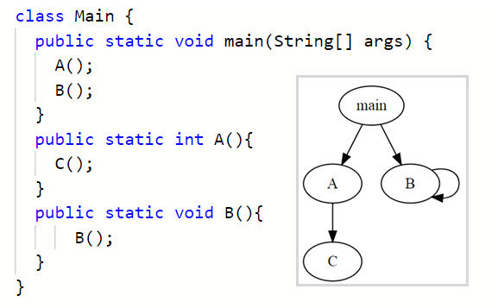
Recap: Call Graph
Nodes: Functions
Edges: Call sites.
Call graph represents possible runtime transfers between functions for interprocedure anaylsis
Notes:
add “possible” for more general description

Slide 57
Procedure Placement
Given a call graph, procedure placement rearranges the locations of procedures in memory to
Reduce virtual-memory working-set sizes
Limit the potential for call-induced conflicts in the instruction cache.
Unfortunately, we cannot always place multiple callees next to the caller. Thus, procedure placement tends to greedily find a good placement, rather than an optimal one.
Notes:
減少可能使用的虛擬記憶體的範圍，將經常被呼叫的函式及其相關數據放置在記憶體中較靠近的位置，可以限制需要載入到實體記憶體的頁數。這樣可以降低頁錯誤（page faults）的發生機率，因為當系統需要頻繁地在記憶體中交換數據時，執行速度會大幅減慢 limit … 經常被呼叫的 procedures 排在cache 中比較靠近的位置，能夠最小化 cache misses 的機率，並且相關的指令可以更有效率地載入。這樣可以減少 memory access 的時間，並且提升整體程式效能

Slide 58
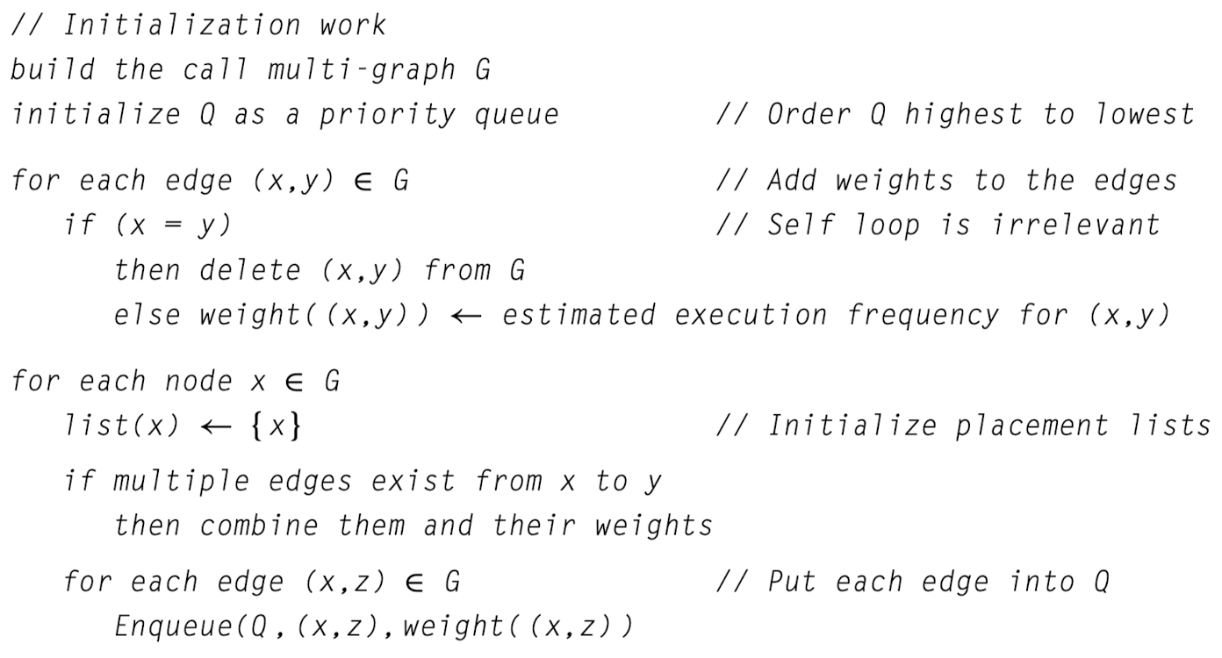
Procedure Placement: Algorithm

Slide 59
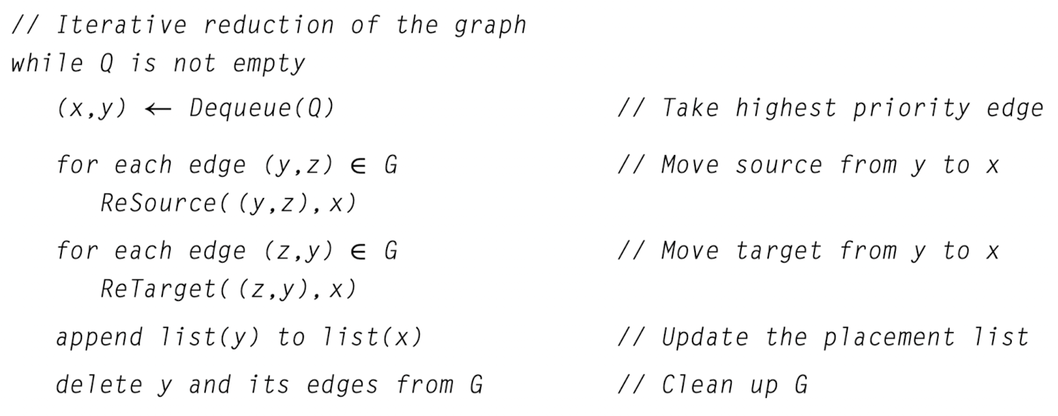
Procedure Placement: Algorithm (Cont’d)
Notes:
沒有更多資訊的話隨機選去 break tie for Q，有的話再去profile去做其他判斷
因為點 y 要刪掉 ReSource 把 y as source 改成 x as source for the target z, that is, (x, y) and (y, z) become (x, z)

Slide 60
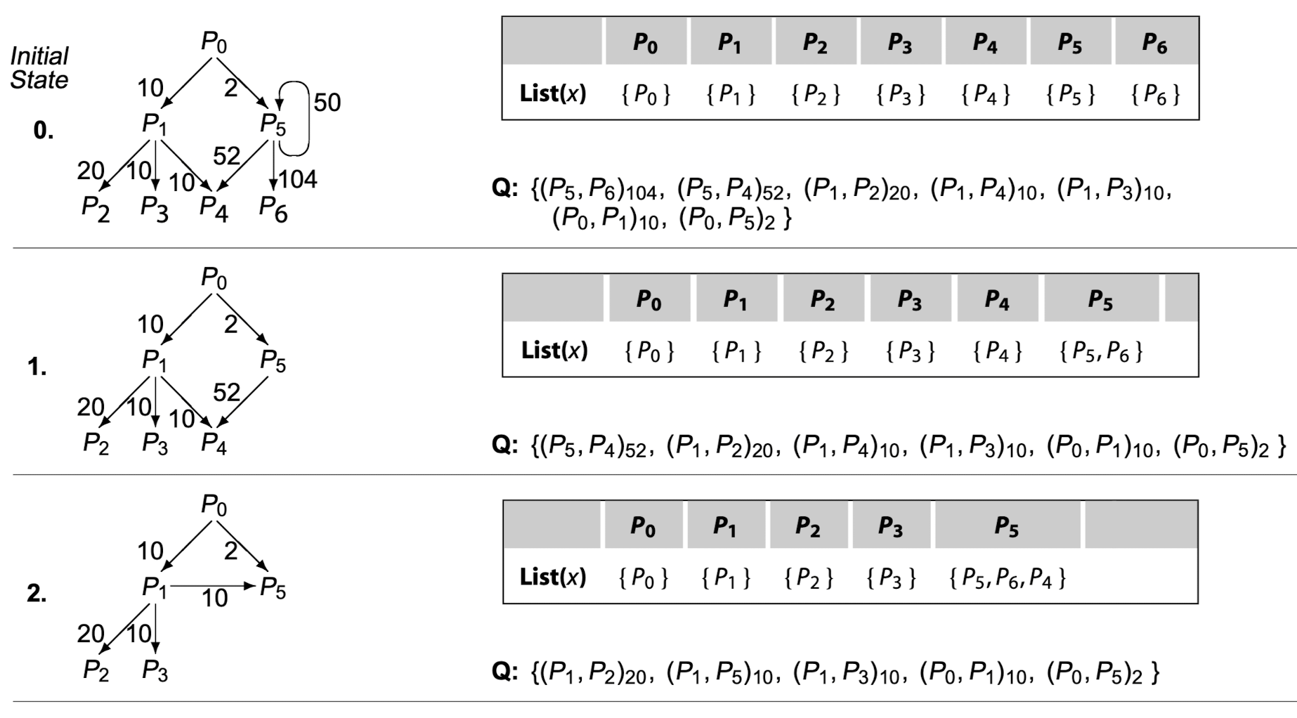
Procedure Placement: Example
…

Slide 61
Interprocedural Optimization: Compiler Organization
There are different compiler structures to perform whole-program or interprocedural optimization to
Address the dependence of the procedures’ states of different compilation unit
Access to the needed code from other compilation units for the program.
Enlarging Compilation Units: The simplest way, however, it cannot introduce the dependence between the compilation units and should not fully access to other units.
Link-time Optimization: A compiler can shift interprocedural optimization into the linker, where it has access to all the statically linked code.
…, etc.
Notes:
Interprocedural Optimization會影響編譯器的組成，我們可以考慮不同的架構，而這些架構都在試著達到下面兩個目的...

Slide 62
References
Engineering A Compiler (3rd. ed.).
8.5 Regional Optimization
8.6 Global Optimization
8.7 Interprocedural Optimization
10.3 Code Motion
Compilers: Principles, Techniques, and Tools (2nd. ed.).
Computer Organization and Design RISC-V Edition (2nd. ed.).
Computer Architecture : A Quantitative Approach (6nd. ed.).
CS 153: Loop Optimization
Notes:
P406
Lazy Code Motion

